Slide 1
Retail Lending 2025
Canara Bank Officers’ Association
Internal

Slide 2
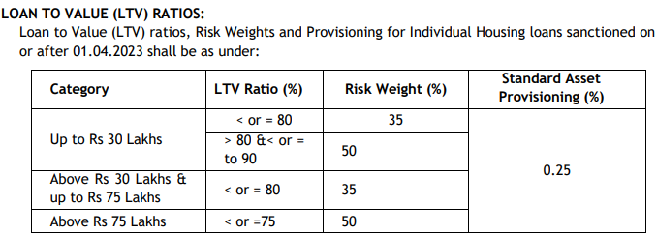
Retail Lending
All Retail loan proposals received shall be inwarded in NB-179.
All sanctions to a borrower exceeding total exposure (FB+NFB) of Rs.5.00 lakhs
The Key Fact Statement shall be valid for period of at least three working days for loans having tenor of seven days or more, and a validity period of one working day for loans having tenor of less than seven days.
Embargo on Retail lending
  5% NPA under any Retail Lending scheme
  Restructured/rescheduled HLs shall attract additional risk weight of 25%
Internal
Internal

Slide 3
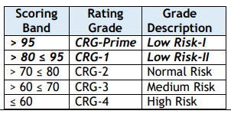
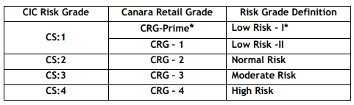
Retail Lending
Score band for CRG rating model
Internal
Internal

Slide 4
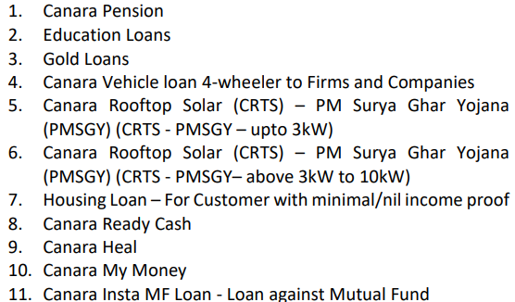
Retail Lending
CRG Prime is applicable to Housing Loans and Canara Vehicle 4-wheeler loans for arriving at ROI
CRG Rating is not applicable to schemes
Internal

Slide 5
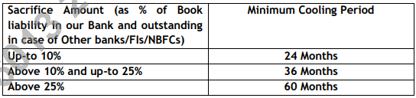
Retail Lending
Cooling period and Sacrifice Amount
  Written off accounts/credit card receivables with write-off amount up-to Rs. 10000.00 reported as non-wilful default in CICs may be ignored after a cooling period of 24 Months from the date of settlement/ write off.
  Written off accounts/credit card receivables with write-off amount up-to Rs. 10000.00 reported as nonwilful default in CICs may be ignored after a cooling period of 24 Months from the date of settlement/ write off.
Internal
Internal

Slide 6
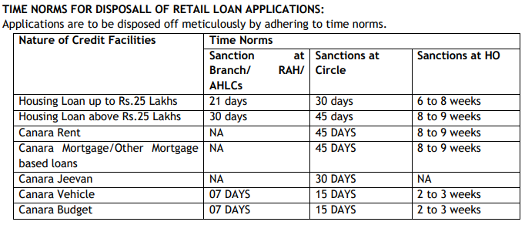
TAT for retail loans
Internal
Internal

Slide 7
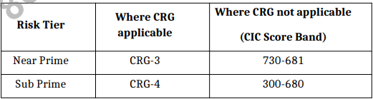
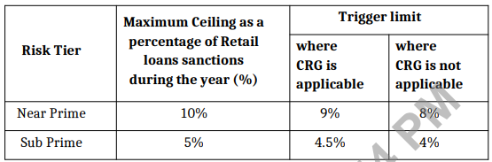
Risk Tier for Retail lending
Risk Tiers for Retail Borrowers:
  Risk tiers is introduced based on Canara Retail Grade(CRG) and CIC score (wherever CRG is not applicable) for all the retail lending schemes as under
  Additional ROI of 0.25% for Sub Prime borrowers.
  Ceiling will be monitored on Quarterly basis by RM Wing
Internal
Internal

Slide 8
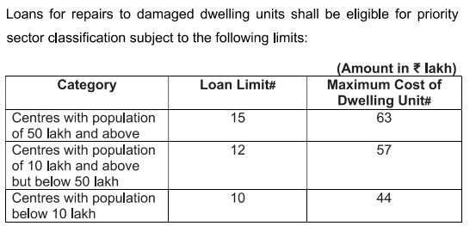
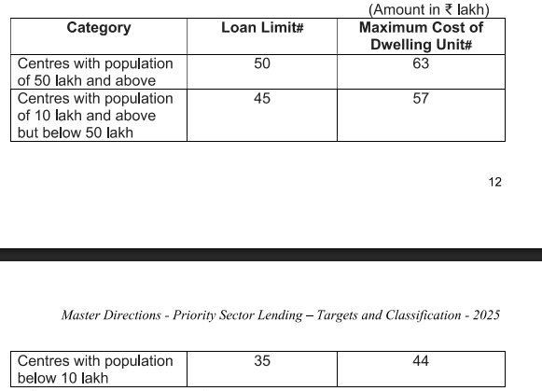
Priority Sector under Retail Lending Schemes
Loans for educational purposes, including vocational courses, not exceeding ₹ 25 lakh will be considered as eligible for priority sector classification. Loans currently classified as priority sector will continue till maturity.
Internal

Slide 9
Review of Long Term Retail Loans
All Retail mortgage based loans with present exposure above Rs. 100.00 lakhs & all Education loans backed by mortgage with present exposure above Rs.50.00 lakhs shall be within the scope of the Review .
Each eligible Retail loan (Regular & standard) shall be reviewed within 2 years from the date of first disbursement for the first time.
All Retail Loans up to Rs.5.00 crore sanctioned by Circle Head CAC and above authorities are exempted from the applicability of Annual Review of Term Loan
Internal

Slide 10
Switchover from Floating to Fixed ROI regime
During the reset of interest rates/regime linked to respective loan accounts, option shall be provided to the Borrower/s to switchover from floating rate regime to fixed rate regime or vice-versa during the residual tenor of the loan account.
For Housing Loan (all variants):
The number of times a borrower shall be allowed to switchover to respective interest regimes shall be restricted to “3” times & reset period shall be minimum 3 years between switchovers
All other EMI based Retail Loans
The number of times a borrower shall be allowed to switchover to respective interest regimes shall be restricted to “2” times & reset period shall be minimum 3 years between switchovers.
Internal

Slide 11
Key Facts Statement for Retail Borrowers
All new Retail term loans customers sanctioned on or after October 1, 2024, including fresh loans to existing customers, shall be provided with Key Fact Statement (KFS) to help them take an informed view before executing the loan contract.
The Key Fact Statement shall be valid for period of at least three working days for loans having tenor of seven days or more, and a validity period of one working day for loans having tenor of less than seven days.
Any fees, charges, etc. which are not mentioned in the KFS, cannot be charged by the bank to the borrower at any stage during the term of the loan, without explicit consent of the borrower
Internal

Slide 12
FREQUENCY OF VALUATION OF SECURITIES BY VALUERS IN BANK’S PANEL
Housing Loan variants, Canara Mortgage, Canara Rent, Canara LRD, Canara Site & Education Loans where loan outstanding is Rs. 50 Lakh or above, revaluation of property has to be undertaken through the empanelled valuers once in every five years.
Bank shall obtain minimum 2 independent valuation reports from 2 empanelled valuers in respect of loan accounts where the value of individual property (Land and Building) obtained as collateral for the loan is Rs. 5 crore and above.
If the land is acquired / purchased beyond preceding one year, 85% of the Fair Market Value assessed by the Bank’s approved Valuer should be taken as value of the land.
Internal

Slide 13
RERA Guidelines
RERA registration is mandatory for projects exceeding 500 square meters or with more than 8 units, including both new and ongoing projects that haven't received a completion certificate Teacher’s Loan.
Where the promoter/developer is owner of the land, the proceeds of Housing Loans sanctioned for purchase of property under RERA Registered Projects shall be disbursed only to the RERA Approved Escrow Account.(where 70% of buyer funds are mandated to be deposited) .
In case, number of Housing units financed in a single block/tower of a particular project exceeds 25% (or) 20 units whichever is higher & upto 50% (or) 20 units whichever is higher of the total units, prior clearance shall be obtained from Circle Head CO-CAC for further lending under the said project.
In case, number of Housing units financed in a single block/tower of a particular project exceeds 50% (or) 20 units whichever is higher of the total units, prior clearance shall be obtained from GM/CGM-HOCAC for further lending under the said project
Internal

Slide 14
Introduction of tie-up arrangement with Corporate Vehicle Direct Selling Agents
Applicable in Metro/Urban Centres of our Bank
At present M/s Girnar Software Private Limited (GSPL) (Business Name: CarDekho) is empaneled under the tie-up arrangement as Corporate Vehicle Direct Selling Agent to route Canara Vehicle (4- Wheeler) loan leads/business to our Bank.
1.30% of disbursed loan amount with a maximum of Rs 1,00,000/- for each disbursed proposal. 
The above payment to be permitted by Circle Head.
Internal

Slide 15
Retail lending
New Schemes under Retail Lending
Canara Insta Mutual Fund.
For both, Existing to Bank and New to Bank Customers as both Term Loan and Overdraft.
Mutual Funds units belonging to all 43 Asset Management Companies (AMCs).
Repayment: Term Loan: Repayable in 36 EMIs maximum headroom of 1 year. Moratorium: NIL
Customer shall have a CIC score of 700 and above
Staff are also eligible to avail the loan subject to 30% Net Take Home (NTH).
In case of Equity/Hybrid Mutual Fund-50% of NAV with minimum of Rs.25000/- and maximum of Rs.10,00,000/- In case of Debt Mutual Fund, 75% of the NAV with minimum of Rs.25000/- and maximum of Rs. 1 Crore.
LTV ratio shall be 50% in case of equity MF or 75% in case of Debt MF and required margin to be maintained at all time during the currency of the loan. In order to monitor and avoid LTV breach, a trigger shall be initiated at specific LTV levels and suitable intimations in form of SMSs shall be provided to the borrowers to regularize the limits within T+4 working days. If the same is not complied, proceedings for liquidation of the Mutual Funds lien marked to the loan shall be undertaken. In case of Equity Mutual Funds-Trigger shall be at 60% LTV. In case of Debt Mutual Funds-Trigger shall be at 80% LTV.
Post disbursement maintenance of all loan accounts under the new product shall be mapped to Mumbai Capital Market Services Branch (15076)
Internal

Slide 16
Canara Rooftop Solar (CRTS) – PM Surya Ghar Yojana (PMSGY) (CRTS - PMSGY – upto 3kW)
Loan Quantum Maximum upto Rs.2.00 lakh (including subsidy) up to 3kW and Maximum upto Rs.6.00 lakh (including subsidy) above 3kW to 10kW.
Subsidy: Rs. 30,000/- per kW shall be provided up to 2kW rooftop systems, and additional subsidy of Rs. 18,000/- per kW shall be provided for above 2 kW & upto 3kW Systems. For Systems above 3kW subsidy capped at Rs. 78,000/-
Margin – 10%
No minimum Annual Income & NTH criteria
Minimum entry age 18 years & Maximum entry Age 75 years.
Wherever the age of the applicant is beyond 65 years the loan shall be sanctioned along with the co-obligation of legal heir aged below 60 years.
Repayment period of maximum 10 years. However, repayment shall be fixed in such a manner that the Borrower age shall not exceed 75 years by the end of the repayment tenor.
680 & above and (-1 to 99 in case of borrower having no credit history – branch head
Our Employees / Ex-Employees: RO Head
Upfront disbursement to the vendors shall be made to the extent of 70% of the project cost (Including margin money of 10% to be contributed by the customers) and the remaining 30% will be disbursed within 30 days of satisfactory installation and post installation verification by the bank.
Internal

Slide 17
Canara Rooftop Solar (CRTS) – PM Surya Ghar Yojana (PMSGY) (CRTS - PMSGY– above 3kW to 10kW)
Maximum Loan upto Rs.6.00 lakh (including subsidy)
Rs. 3.00 Lakh Minimum Annual Income
NTH: Applicant should have minimum monthly net take home income of 25% of their gross income OR Rs. 10,000/- whichever is higher after meeting the existing loan instalments along with the proposed loan
Subsidy support Rs 78000.00
Branches are not empowered to reject any proposals originated through Jansamarth Portal. Next Higher Authority shall be the authority to reject the proposals received under the Jansamarth Portal.
Internal

Slide 18
NEW RETAIL GOLD LOAN SCHEME – SWARNA MONTHLY INTEREST
Minimum Amount: Rs.5000.00 • Maximum: Rs.35.00 Lakh
Rate of Advance shall be maximum 75% of the Appraised Value of Gold.
Interest charged to be serviced as and when due at monthly intervals. Principal is to be repaid within 12 months from the date of sanction or as bullet payment on maturity.
Loan to Value (LTV) ratio shall not exceed 75% during the tenure of loan
Internal

Slide 19
“Canara-HEAL” Healthcare (Emergency Healthcare STP) scheme under Retail Segment.
-A special scheme for funding the shortfall of hospital expenditure while settling the claims of self and/or dependents through TPAs to both Existing & New customers by way of Straight-through-Processing (STP) Healthcare loan.
Customer should have a valid Health Insurance Policy.
Aged between 21-55 years.
Existing: Salaried & Non-Salaried Customers •
New: Only Salaried Class Customers (minimum salary credit of Rs. 50,000/- per month in the account)•
Customer shall have CIC Score of 700 & above •
Customer should not have slipped to SMA/NPA category in last 12 months, if already availed any credit facility
Minimum loan quantum Rs 25000.00, maximum Rs 5.00 lakhs
For Salaried Customer: Six times of the average of last 3 months salary credited in the salary account
Minimum Net Take Home Salary (NTH) of borrower should not be less than Rs. 10,000/- p.m. after meeting instalments of all existing loans and proposed loan.
Internal

Slide 20
Canara-HEAL- contd..
No Minimum Credit turnover in the Salary A/c is required. ✓
In the last 6 months, atleast 4 times monthly salary shall be credited subject to mandatory salary credit in the savings bank during 2 preceding months from date of loan application. ➢
For Existing customer having the salary account with other Bank, the eligibility criteria is as under: ✓
During the last 6-months, the customer shall maintain Minimum Average SB Balance of Rs 50,000/- in savings account of our bank & having minimum credit turnover of Rs. 1.00 lakh & Debit turnover of Rs. 0.75 lakhs
For New Customers, Last 3 months salary slips/PF Statement shall be validated & last oneyear bank statement shall be uploaded
Loans under “Canara HEAL” Scheme for customers suffering with terminally illness shall be availed at branches----NEW
Funds will be available for 15 days from the date of disbursement to avail through “Credit Line on UPI” and on 15th day-end any unutilized loan portion shall be cancelled
36 EMIs with 2 months moratorium.
Funds available under “Credit Line on UPI” shall be available for utilization for the customer after applicable Cooling Period as per NPCI Guidelines from time to time (Presently being 24 Hours for Android Users & 72 Hours for iOS Users)
Internal

Slide 21
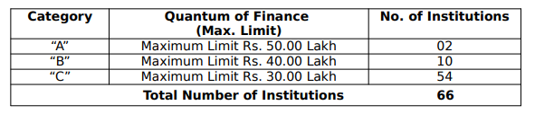
From Circulars
Education Loan margin and/or the disbursement proceeds are not credited to the savings accounts held in the name of minor, wherein aggregate withdrawals shall not exceed Rs. 10,000/- in a month.
In addition to existing 56 services, new facility to generate TDS/ Interest Certificate through BC Channels. commission charges for TDS/Interest Certificate generation facility through BC channel @ Rs. 10/- + GST for each successfully generated TDS/Interest Certificate.
Under the PM-Vidyalaxmi (Unified) Portal, application fee of Rs. 200/- plus GST per application shall be collected upon successful disbursement of education loan application.
To facilitate easier arrangement & balancing of loan documents, 17-digit Sequence Number has been implemented for Retail Loans in CBS. First five digits is Branch DP Code, next two digits denote Year of Loan in YY format, next five digits is Product Code and next five digits shall be running serial number for the particular product
Internal

Slide 22
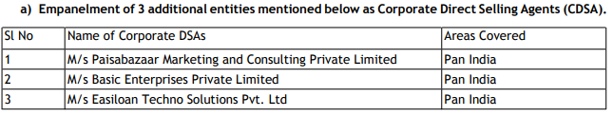
Contd..
Provisioning for standard HL- 0.25%, CRE-HL- 0.75%
Inclusion of Additional Clause of Unique Land Parcel Identification Number (ULPIN) in Legal Scrutiny report(LSR) as part of legal scrutiny w.e.f 01-05-2025.
Restriction for RAH and Branches from the fresh issuance of Credit Card w.e.f 10.03.2025 where the Non-Performing Asset (NPA) liability of the Credit Card portfolio of an RAH or Branch surpasses 5% of its total credit card outstanding.
The validity of digital consent obtained from customer shall be 72 hours.
At present 15 Corporate DSAs under tie-up arrangements to route housing loan leads/business to our Bank.
Internal

