Slide 1
Retail Lending 2025
Canara Bank Officers’ Association
Internal

Slide 2
Housing Loan
Quantum of Loan : Salaried class: 72 times last drawn monthly gross salary (Regular income to be ascertained by verifying previous 6 months’ salary slips).
For non- Salaried class: 6 times of annual gross income (Average of three preceding years annual Income) i.e. the financial years immediately preceding the current financial year during which the customer desires to avail housing loan.
Minimum percentage of Net Income/NTH to 25% (after meeting the instalment for the proposed Housing Loan) at the time of availing the loan subject to the condition that the minimum amount of Net Income/NTH quantum shall be stipulated at Rs.10,000/-
NTH for increased loan quantum of 84 times/ 7 times (LOW and NORMAL risk)
  25% NTH or Rs.20000/- whichever is higher
Internal

Slide 3
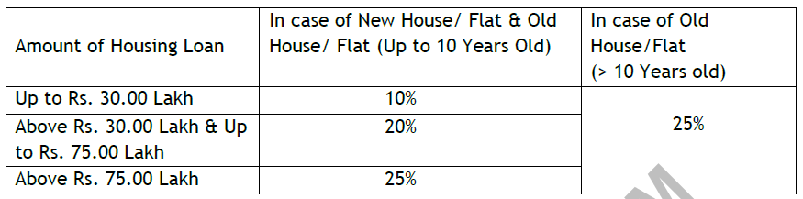
Housing Loan contd…
  Margin
  For all Housing Loans Sanctioned for 3rd unit and above classified under HL NP CRE (Commercial Real Estate), Rate of Interest chargeable is 0.25% for 3rd unit, 4th and subsequent unit 0.50% above Card Rate (applicable to all Housing Loan variants).
  Where housing loan is granted for purchase of site and construction of house thereon, the borrower should start construction of the house within a maximum period of twelve months from the date of disbursement of the house loan.
  RERA registration is not applicable, in the case of projects where the plot size is below 500 Sq.mtrs and not having more than 8 units.
The residual life of the property must be 10 years more than the repayment end date in the case of financing already built house.
Internal

Slide 4
Housing Loan contd…
In the case of purchase of ready built house/flat: The repayment should commence within TWO MONTHS from the date of first disbursement.
In case of purchase of Site & Construction of House thereof AND OR only construction of House in the existing Site: The Repayment should commence within 2 months after completion of House OR 24 months from the date of first disbursement whichever is earlier.
In case of purchase of flat under construction: The Repayment should start within 2 MONTHS of completion of construction OR 36 MONTHS from the date of first disbursement, whichever is earlier.
Circle Head CO CAC can extend additional repayment holiday of 12 months (beyondpermissibleholidayperiodof24months) for construction of house and GM/GM-HO-CAC can extend additional repayment holiday of 12 months (beyond permissible holiday period of 36 months) for flat under construction. The moratorium period is included within the maximum repayment period.
Internal

Slide 5
Canara Kuteer
Individual house hold Income in Rural, Urban, Metro areas and members of Self Help Groups
I. Up to Rs.1,00,000/- p.a.
II. Above Rs.1,00,000/- & up to Rs.3,00,000/- p.a
Maximum quantum of loan:
i. For Household income of Up to Rs.1,00,000/- p.a max quantum is Rs. 5,00,000/-
ii. For Household income of above Rs. 1,00,000/- & up to Rs. 3,00,000/- p.a maximum quantum is Rs.10,00,000/-
NTH: Shall not fall below 60% of Gross annual income
Internal

Slide 6
CANARA HOME LOAN PLUS
Individuals aged between 18 and 75 years, who have already availed Housing Loans with satisfactory repayment of the loan promptly for irrespective of the period of run with our Bank
24 months’ gross salary subject to a maximum of Rs.50.00 lakhs
Two times of 3 years average gross income of the applicant subject to a maximum of Rs.50.00 lakhs.
NTH 25% for salaried class and 30% for non salaried class.
Where housing loan is availed for outright purchase of property, value at the time of sanction only shall be reckoned. However, after ensuring gap of minimum two years between two valuations, fresh valuation may be reckoned for determining the loan quantum
Maximum tenor : 360 months r left over repayment period for the existing Housing Loan whichever is less (CGM HO CAC).
Internal

Slide 7
Housing Loan to Agriculturists
All agriculturists owning and cultivating agricultural lands of more than 5 acres (Irrigated lands) / 10 acres of Dry lands in their name.
For considering Housing Loans to agriculturists engaged in Dairy farming, Poultry farming, Plantation Crops and Horticultural produce, the minimum land holding levels need not be applied. These categories of borrowers can be financed provided their minimum gross annual income is Rs.5.00 Lakh.
For Housing Loans for agriculturists, income certificate issued by the Tahsildar/ Mandal Revenue Officer/District Revenue Authorities or any competent authority may be accepted as proof of income for reckoning the housing loan quantum if Income Tax returns are not available.
The moratorium period shall not exceed 3 harvesting seasons in case of half yearly installments and 2 harvesting seasons in case of yearly installments.
Internal

Slide 8
Housing Loan to NRIs
Minimum age 21- years and maximum age by which loan is to be repaid is 60 years
Circle Head-CO-CAC and above authorities can very selectively permit up to their delegated powers the repayment period up to 30 years or till the borrower attains the age of 70 years
➢ The applicant should have NRI status for atleast 3 years.
➢ Circle Head-CO- CAC and above authorities can very selectively permit following relaxation up to their delegated powers;
Minimum employment abroad of 2 years to 1 year with valid job contract/work permits.
NRI Status from 3 years to 1 year.
Maximum loan amount shall be Four times of annual gross income subject to NTH of 40% after proposed EMI and meeting the margin requirements.
RAH Head/RO Head-CAC/AGM-CO-CAC up to their delegated powers and above sanctioning authorities can relax the following upto their delegated powers in Respective of Housing Loan-Higher quantum of loan up to 5 years of gross annual salary/Income.
Internal

Slide 9
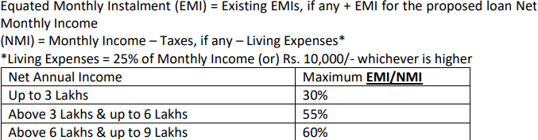
Housing Loan – For Customer with minimal/nil income proof (85/2025)
Metro/Urban areas., Salaried/non-salaried class with annual income up to Rs. 9.00 lakhs having no home or one Home; (Income of up to 4 members of the household can be combined to calculate eligibility)
CIC Score of 650 and above A satisfactorily maintained Running Bank Account / UPI transaction history for a minimum period of 24 months
Entry age Minimum 21 Years Maximum 60 Years.
For Home Loan: ▪ Metro Centres: Rs 35.00 Lakhs, subject to Max Project Cost of Rs. 45.00 Lakhs ▪ Other Centres: Rs 25.00 Lakhs, subject to Max Project Cost of Rs. 30.00 Lakhs
For Repair and Renovation: ▪ Metro Centres: Rs. 10.00 Lakhs ▪ Other Centres: Rs. 6.00 Lakh

Slide 10
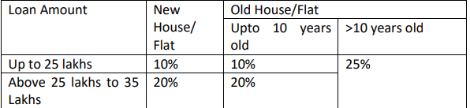
Contd…
Salaried Customers: If Salaried and receiving salary through Bank Account (SB/CA), the average annual salary credit will be taken as annual income. (Average for last 12 months). Self-Employed Customers: Self-employed individuals maintaining Account (Current / CC / SB in the name of the Firm or in his personal name), Credit Summation of 8% of annual credit summation of non-digital transactions & 20% of total credit summation of digital transactions shall be considered as Annual Income. (Average for last 12 months). Or If the applicant is assessed under GST, then 8% of their Sales Turn over declared in the GST returns will be considered as Annual Income (section 44AD, income is computed on presumptive basis at the rate of 8% of the turnover or gross receipts of the eligible business for the year).

Slide 11
Contd…
Maximum: 25 years (300 Months) * * Subject to full repayment before the youngest earning borrower attains the age of 70 years
Housing loans upto Rs. 20 lakh sanctioned and disbursed to eligible beneficiaries/ borrowers under this scheme for construction or purchase of first house with a carpet area upto 60 Sqm are eligible to cover under Credit Risk Guarantee Fund Trust for Low Income Housing Scheme (CRGFTLIH Scheme) by National Credit Guarantee Trustee Company Limited (NCGTC)”.
Fintech Partner “M/s ScoreMe Solutions India Private Limited” shall analyze and provide Credit/Debit turnover/transactions in the account.

Slide 12

Pradhan Mantri Vidyalaxmi (PM-Vidyalaxmi) Scheme” - for Pursuing Higher Education in India in Quality Higher Educational Institutions (QHEIs) identified by Ministry of Education (MOE)
no maximum ceiling of loan amount .
For Students, whose annual family income is up to Rs. 4.5 lakhs, shall be eligible for full interest subvention during moratorium period for education loan up to Rs. 10 lakhs. ➢ For, students whose annual family income is between Rs. 4.5 lakhs and Rs. 8 lakhs shall be eligible to apply for 3% interest subvention during moratorium period for education loan up to Rs. 10 lakhs.
Loan amounts upto Rs.7.50 lakhs will be provided a 75% credit guarantee by the Government of India under CGFSEL.
Students admitted through management quota (or similar quota) will not be eligible.
Obtention of life insurance cover is mandatory for the loan amount above Rs7.50 lakh

Slide 13
Canara Vehicle 2 wheeler
Salaried : minimum Gross Salary of Rs.1.75 Lakh p.a. and net take home salary of 35% of gross salary
Non salaried : minimum annual income of Rs 2.00 lac and above to be evidenced by ITAO/ITR (Income Tax Assessment Order/Income Tax Return)
Category of Branch --Min. Invoice value of the vehicle (considered for sanction)
  Metro/Urban Branches -- Rs.1.00 lac and above
  Semi Urban/Rural Branches -- No Minimum Limit
MARGIN: Salaried
(i) 15% (Existing Customers)
(ii) 20% (New Customers)
Non-salaried
(i) 25% (Existing Customers)
(ii) 35% (New Customers)
A repayment period not exceeding 60 months
Internal

Slide 14
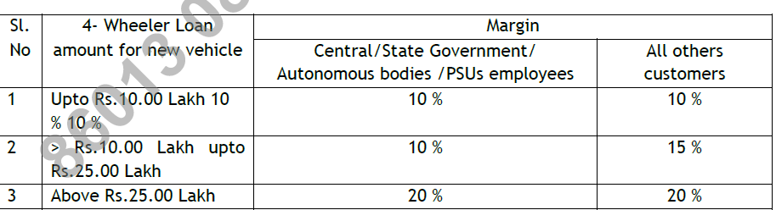
Canara Vehicle 4 wheeler
Salaried individuals (with or without salary tie-up) should have a minimum gross salary of Rs.3.00 lakh p.a. Net take home (NTH) salary after taking into consideration the instalment
NTH 5% of the gross salary/ income or Rs.12,000 pm whichever is higher
Non salaried: minimum gross annual income (Cash accruals) of Rs.3.00 lakh p.a. as per latest ITR/ITAO subject to 3 years Gross Average Annual Income of not less than Rs.2.50 lakh.
For Pensioners- Net Take Home should be 50%.
Margin
Internal

Slide 15
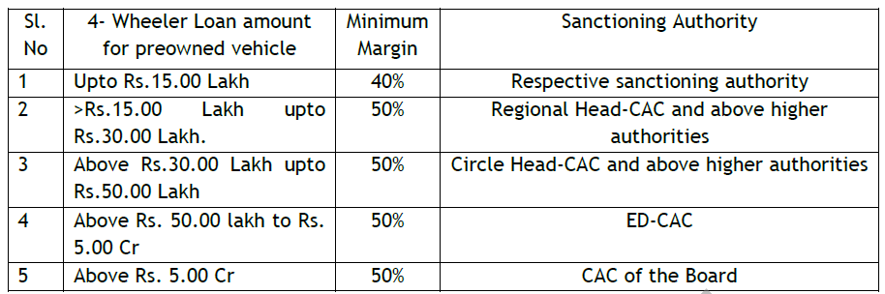
Canara Vehicle 4 wheeler contd
Quantum of loan: Pre-owned (4 wheeler):
60% of the value of vehicle as appraised / assessed by an automobile engineer.
60% of the price agreed to between the seller and the buyer.
➢ 60% of the original purchase price of the vehicle.
➢ Max Rs.50.00 lakh
which are not older than THREE years.
Vehicles which are not older than 1 month from the date of their purchase / first registration (registered within one month) can be treated as new vehicle and the same can be financed on the terms and conditions as applicable for purchase of brand new vehicles. However, in all such cases, our borrower should be the first transferee
Repayment – 60 months
Internal

Slide 16

Canara Vehicle contd
The payment of service charges to Car Dealers and Sales Executives, i.e., 1.30% of loan amount with a maximum of Rs. 1,00,000/- and Rs. 1,500/- respectively, can be made flexible between both within the overall permissible cap.
Report from any one CIC for loans upto Rs 5.00 lakhs
Internal

Slide 17
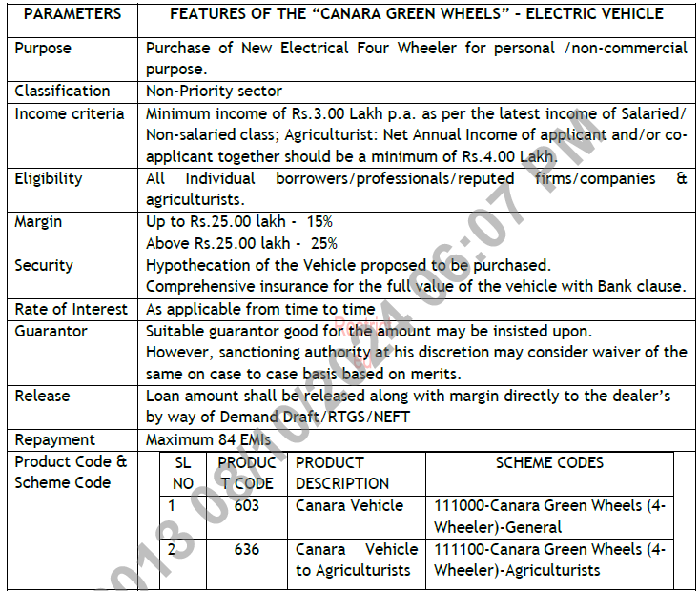
Canara Green wheels
Internal

Slide 18
Canara Vehicle to Agriculturists
All agriculturists owning and cultivating agricultural lands of more than 5 acres of irrigated lands/10 acres of dry lands in their name.
For considering Canara Vehicle Loans to agriculturists engaged in Dairy Farming, Poultry Farming, Plantation Crops and Horticultural Produce, the minimum land holding levels need not be applied. These categories of borrowers can be financed provided their minimum gross annual income is Rs.4.00 lakh.
ITR not mandatory for loans upto Rs 10.00 lakhs
in case of loans above Rs.10 Lakh, ITR is to be compulsorily insisted upon, where agricultural income is also declared. If the same is not available, prior clearance from RO-Head–CAC (for sanctions below RO-Head CAC) is to be obtained for sanction of loans by respective sanctioning authority.
Net Take Home (NTH) should be 40% of gross annual income at the time of applying for loan (after meeting the installment for the proposed loan under this scheme) with a minimum of Rs.1.50 lakh/- p.a. CGM/GM-CO-CAC & above authorities are empowered to permit relaxation in NTH from 40% to 25% with a minimum of Rs.1,00,000/-p.a. selectively as per their respective delegated powers.
Internal

Slide 19
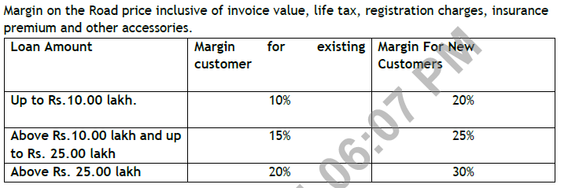
Canara Vehicle to Agriculturists contd
Accessories can be financed limited up to Rs.25,000/-.
Internal

Slide 20
Canara Mortgage
50% on the value of the property proposed to be offered as security as per the valuation report given by the panel valuer of the Bank.
Salaried class: Low/Normal CRG grade - 96 times last drawn monthly gross salary (Regular income to be ascertained by verifying previous 6 months’ salary slips).
Non- Salaried class: Low/Normal CRG grade - 8 times of cash accruals (Average of the last three preceding years annual cash accruals) i.e. the financial years immediately preceding the current financial year during which the customer desires to avail loan.
NTH of 30% or Rs.25,000/- whichever is higher after meeting the existing and proposed EMIs.
ii) Salaried class: Medium/High CRG grade - 84 times last drawn monthly gross salary (Regular income to be ascertained by verifying previous 6 months’ salary slips).
Non- Salaried class: Medium/High CRG grade - 7 times of cash accruals (Average of the last three preceding years annual cash accruals) i.e. the financial years immediately preceding the current financial year during which the customer desires to avail loan.
minimum NTH of 35% or Rs.30,000/- whichever is higher after meeting the existing and proposed EMIs.
Canara Mortgage proposal up to Rs.750 lakh falling under HO powers shall be processed by Retail Assets Wing and beyond Rs.750 lakh shall be processed by the respective corporate credit wings at HO.
Internal

