Slide 1
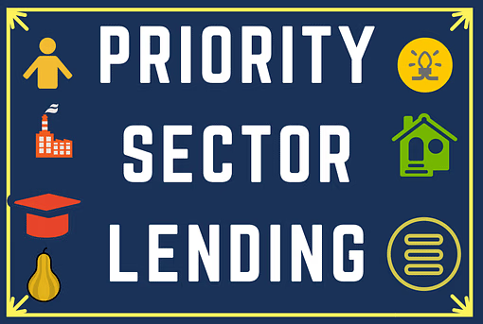
PRIORITY SECTOR CREDIT- 204/25
Session will resume at 3.55 pm
RBI - PRIORITY SECTOR GUIDELINES
RAVI KUMAR-PROMOTION NOTES
Internal
Notes:
Kindly make use of this notes part in all the ppts.
Remember, ppt cannot have lengthy sentences
Remember the Rule of 7
7 Slide
Each Slide 7 Lines (Except in case of Definitions or legal terminology)
Each line 7 words
Kindly try to use standard font and avoid using all capital letters in sentences

Slide 2

What is Priority Lending : Lending to those sectors of the economy which should receive timely and adequate credit.
GOI AND RBI consider as important for the development of basic needs of country.
PURPOSE : Better credit flow to credit deficient areas/required areas like SF/MF/WEAKER SECTION . Boost credit in important areas like Renewable energy/Social infrastructure .
Advantage of Priority Lending : Better credit penetration to credit deficient areas and increase loans to SF/MF/Weaker sections/ Renewable energy/Social infrastructure. (which enabled over all development of our country, exports, employment etc.,)
What is Non-priority : CAR loan
KNOWLEDGE CHECK (Let u see)
Internal
Internal

Slide 3
PRIORITY
A service enterprise with investment of Rs 1 Cr in Equipments and turnover of Rs 7.50 crs will be classified as
1) Small
2) Micro
3) Mudra
4) Medium
5) All options are wrong
Internal

Slide 4
As per the revised definition of MSMEs as per latest Gazette Notification, If the Investment in Plant & Machinery or Equipment does not exceed 50 Cr and turnover does not exceed 250 Cr; the enterprise will be classified as __________
1) Small
2) Micro
3) Mudra
4) Medium
5) Tiny unit
Internal

Slide 5
As per the revised definition of MSMEs as per latest Gazette Notification S.O. 2119 (E) dated June 26, 2020, If the Investment in Plant & Machinery or Equipment does not exceed 1 Cr and turnover does not exceed 5 Cr; the enterprise will be classified as __________
1) Small
2) Micro
3) Mudra
4) Medium
5) Tiny unit
Internal

Slide 6
Under Social Infrastructure ,Bank loans up to a limit of ₹……….per borrower for setting up schools, drinking water facilities and sanitation facilities including construction/ refurbishment of household toilets and water improvements at household level, etc
  1) 5 MILLION
  2) 50 MILLION
  3) 500 MILLION
  4) 5 BILLION
  5) 5 TRILLION
  LET US KNOW THE DIFFERENCE BETWEEN MILLION/BILLION/TRILLION- TO ANSWER PERFECTLY
Internal

Slide 7
6 9 12
PRIORITY (LOGICS)
Internal

Slide 8
PRIORITY (LOGICS)
6 zeros- Million
9 zeros- Billion
12 zeros- Trillion
Internal

Slide 9
Under Social Infrastructure ,Bank loans up to a limit of ₹……….per borrower for setting up schools, drinking water facilities and sanitation facilities including construction/ refurbishment of household toilets and water improvements at household level, etc
  1) 5 MILLION
  2) 50 MILLION
  3) 500 MILLION
  4) 5 BILLION
  5) 5 TRILLION
HOW TO ANSWER : if Answer is 5 crores.
WRITE : 6/9/12 –mil/bil/tril
Now covert 5 crores –(5 + 00,00,000 zeros)-
NOW 50 (000,000-MILLION)
Answer : 50 million
Internal

Slide 10



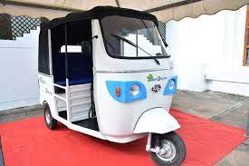
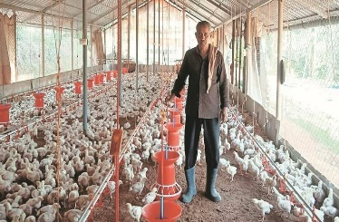

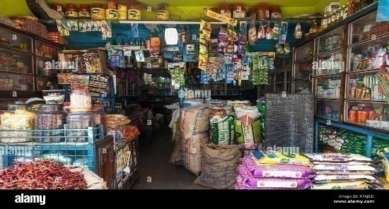
BEFORE GETTING INTO PRIORITY TOPIC,
LET US UNDERSTAND SOME TERMINOLOGIES
ANBC
CEOBE
RETAIL AGRICULTURE (ALLIED ACTIVITIES) & MSME
LOANS TO INVIDUAL CUSTOMERS
MFG
SERVICE
Internal
TRADER
Internal

Slide 11
AS PER RBI PRIORITY TARGET FOR COMMERCIAL BANKS :
40 % OF ANBC OR CEOBE (WHICH EVER IS HIGHER)
WE CAN CONSRTRUED :40 % OF FB OR NFB (WHICH EVER IS HIGHER).
WHAT IS ANBC (FUND BASED LOANS) – NEXT SLIDES
WHAT IS CEOBE (NON FUND BASED LOANS)
CEOBE STANDS FOR Credit Equivalent of Off-Balance Sheet Exposures
Example : BANK BALANCE SHEET
FOOT NOTE : LC– 2OO CR & BG – 400 CR.
ANBC = 500 CR (40%) OR 600 CR (40%)
200 CR OR 240 CR (HIGHER WILL BE TARGET)- 240 CR
LIABILITIES | ASSETS
DEPOSITS – 1400 CRORES | LOANS – 500 crores
Internal
Internal

Slide 12
NON CORPORATE FARMER
Individual farmer includes SF AND MF
Proprietorship firms of farmer (Doing Agri and allied activies)
SGD/JLG (Group of Individual farmers)
Onlending : Loans sanctioned by banks to eligible intermediaries for onward lending. Such loans for creation of priority sector assets and which remain deployed in such assets are eligible.
Internal

Slide 13
Calculation of ANBC:
Bank Credit in India | 1
Bills Rediscounted with RBI and other approved Financial Institution | 2
Net Bank Credit (NBC)* | 3 (1 -2)
Outstanding Deposits under RIDF and other eligible funds with NABARD, NHB, SIDBI and MUDRA Ltd in lieu of non-achievement of priority sector lending targets/sub-targets + outstanding PSLCs | 4 +
Eligible amount for exemptions on issuance of long-term bonds for infrastructure and affordable housing | 5 -
Advances extended in India against the incremental FCNR (B)/NRE deposits, qualifying for exemption from CRR/SLR requirements | 6 -
Investments made by public sector banks in the Recapitalization Bonds floated by Government of India | 7 -
Other investments eligible to be treated as priority sector (e.g. investments in securitised assets | 8 +
Bonds/debentures in Non-SLR categories under HTM category | 9 +
For UCBs: investments made after August 30, 2007 in permitted non SLR bonds held under ‘Held to Maturity’ (HTM) category) | 10 +
ANBC (other than UCBs) : III+IV- (V+VI+VII)+VIII+IX | ANBC
ANBC for UCBs III+IV-VI+X
Internal

Slide 14
.
REWRITE ANBC TO REMEMBER
AS PER RBI PRIORITY TARGET IS 40 % OF ANBC OR CEOBE (WHICH EVER IS HIGHER)
Internal

Slide 15
Calculation of ANBC (AFTER REWRITE)
Bank Credit in India | 1
Bills Rediscounted with RBI and other approved Financial Institution | 2
Net Bank Credit (NBC)* | (1-2) = 3
Outstanding Deposits under RIDF and other eligible funds with NABARD, NHB, SIDBI and MUDRA Ltd in lieu of non-achievement of priority sector lending targets/sub-targets + outstanding PSLCs | ADD
Other investments eligible to be treated as priority sector (e.g. investments in securitised assets) | ADD
Bonds/debentures in Non-SLR categories under HTM category | ADD
Eligible amount for exemptions on issuance of long-term bonds for infrastructure and affordable housing | DEDUCT
Advances extended in India against the incremental FCNR (B)/NRE deposits, qualifying for exemption from CRR/SLR requirements | DEDUCT
Investments made by public sector banks in the Recapitalization Bonds floated by Government of India | DEDUCT
 | ANBC
Internal
Internal

Slide 16
PRIORITY APPLICABLE TO WHICH BANKS :
RBI (ISSUE PRIORITY GUIDELINES)
COMMERCIAL BANKS
&
FOREIGN BANK ABOVE 20 BRANCHES
FOREIGN BANK WITH
LESS THAN 20 BRANCHES
RRB
SFB
LAB
UCB other than salary earners Bank
Internal

Slide 17
CATEGORIES UNDER PRIORITY SECTOR :Total 8
R A M
RETAIL
AGR
I
MSME
1 & 2
RETAIL
3. AGRICULTURE
4.
MSME
5 EXPORT
6. Social Infrastructure
7. Renewable Energy
8. OTHERS
1. EL
2. HL
Internal

Slide 18
TOTAL TARGER UNDER PRIORITY BANKS TO FINANCE
RBI (ISSUE PRIORITY GUIDELINES)
COMMERCIAL BANKS
&
FOREIGN BANK ABOVE 20 BRANCHES
FOREIGN BANK WITH
LESS THAN 20 BRANCHES
UCB
RRB
SFB
40 % OF ANBC OR CEOBE (HIGHER)
40 % OF ANBC OR CEOBE (HIGHER)
32%- EXPORT
75 % OF ANBC OR CEOBE (HIGHER)
75 % OF ANBC OR CEOBE (HIGHER)
60% OF ANBC OR CEOBE (HIGHER)
Micro 7.5%
Weaker 12 %
Internal

Slide 19
RBI ( PRIORITY SECTOR SUB TARGETS)
MF/SF TARGET : 10 %
MF- (1 HEC LAND)
SF (1-2 HEC)
LANDLESS/ORAL/TENANT
SHG/JLG-AGRI/ALLIED
LOAN-2.5 LAC FOR ALLIED ACT
LOAN TO FPO/FPC- LAND HOLDING NOT LESS THAN 75%
COMM BANKS &
FB > 20 BR
SUB TARGET
MICRO
7.5% of ANBC
40 % of ANBC OR CEOBE (HIGH)
SF/MF
AGRICULT
18 % of ANBC
(NCF-14 %)
NCF
SF/MF
SC/ST
DIR
SHG /JLG
Persons with disabilities
Govt Spon NRLM, NULM & SRMS
Minorities /Transgenders
Distressed farmers indebted to non-institutional lenders
Distressed persons upto loan ₹1 lakh)
Women beneficiaries upto 2 lac
(2 Lac not applicable to UCB)
Artisans, village and cottage industries upto ₹2 lakh
AGRICULTURE
NON-COR- 14%
MSME PRIORITY
MSME-
EL -25 LACS
RETAIL
HL/EL
WEAKER SECTION
12 %
WEAKER SEC
12 % of ANBC
EXPORT
INCREMENTAL 2 % ANBC
SANCTION LIM – 50CR
Internal

Slide 20
RBI (PRIORITY SECTOR SUB TARGETS)
FB < 20 BR
RRB
SFB
40 % of ANBC OR CEOBE (HIGH)
75 % of ANBC OR CEOBE (HIGH)
75 % of ANBC OR CEOBE (HIGH)
RETAIL
NO TARGET
18 % of ANBC
NCF – 14 %
(MF/SF 10 %
18 % of ANBC
NCF -14 %
(MF/SF :10 %
AGRI
NO TARGET
MSME-
MSM- PRIORITY (MICR0 7.5%)
MSM - PRIORITY MICR0 - 7.5%
NO TARGET
WEAKER SECTION
10 % to 12 %
NO TARGET
WEAKER SEC
15 % of ANBC
WEAKER SEC
12 % of ANBC
EXPORT
32 % OF ANBC/CEOBE
Internal

Slide 21
  AGRICULTURE ( 3 CATEGORIES)
FARM CREDIT(AGRI & ALLIED)
Agriculture Infrastructure
Ancillary activities
LET US UNDERSTAND THESE 3 CATEGORIES
Internal

Slide 22
FARM CREDIT (2 PARTS)
(PART A : INDIVIDULA FARMERS)
A)Loans to individual farmers
B) including SHG or JLG
C) Proprietorship firms of farmers
(Directly engaged in Agriculture and Allied Activities, viz., Dairy, fishery, animal husbandry, poultry, bee-keeping and sericulture.
CROP LOANS/ SF/MF/PLANTATION/HORTICULTURE
Medium and Long-term loans to farmers for Agcl and allied activities
Loans to farmers for pre and post-harvest activities
Loans to distressed farmers indebted to NON institutional lenders
Loans under the Kisan Credit Card Scheme
Loans to SF/MF for purchase of land for Agriculture purpose
Loans to farmers against pledge/ hypothecation of agricultural produce (including warehouse receipts) for a period not exceeding 12 months
subject to a limit up to
Rs. 90 lakh against NWRs/eNWRs &
upto Rs 60 lakh against warehouse receipts other than NWRs/eNWRs
Loans to farmers for installation of stand-alone Solar Agriculture Pumps and for solarisation of grid connected Agriculture Pumps
Loans to farmers for installation of solar power plants on barren/fallow land or in stilt fashion on agriculture land owned by farmer.
Internal

Slide 23
FARM CREDIT (2 PARTS)
(PART B)
Loans to Partnership firms , Corporate farmers,
FPO / FPC Companies of individual farmers and
Co-operatives of farmers directly engaged in Agcl and Allied Activities
a) Loans for the following activities will be subject to an aggregate limit of Rs. 4 crore per borrowing entity
Crop loans to farmers/Horticulture and loans for allied activities.
Medium and Long-term loans to farmers for agriculture and allied activities (e.g. purchase of agricultural implements and machinery and developmental loans for allied activities).
iii) Loans to farmers for pre and post-harvest activitie(Spraying/Grading/Transport)
b) Loans to farmers against pledge/ hypothecation of agricultural produce (including warehouse receipts) for a period not exceeding 12 months
subject to a limit up to
Rs. 4 Crore against NWRs/eNWRs &
upto Rs 2.5 crore against warehouse receipts other than NWRs/eNWRs
C)Loans up to Rs. 10 Cr per borrowing entity to FPOs/FPCs undertaking farming with assured marketing of their produce at a pre-determined price.
D) Loans upto Rs 10 Cr for purchase of the produce of members directly engaged in agriculture and allied activities
UCBs are not permitted to lend : CO-operative of farmers
Internal

Slide 24
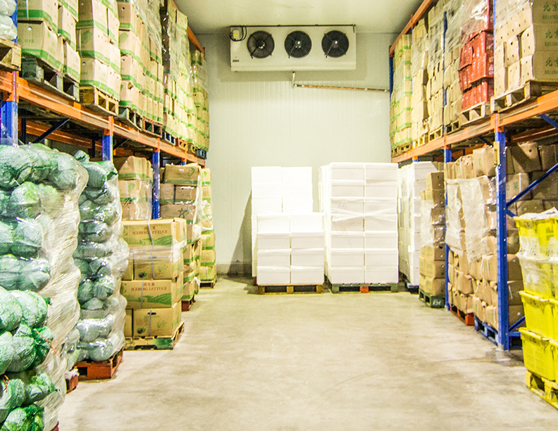
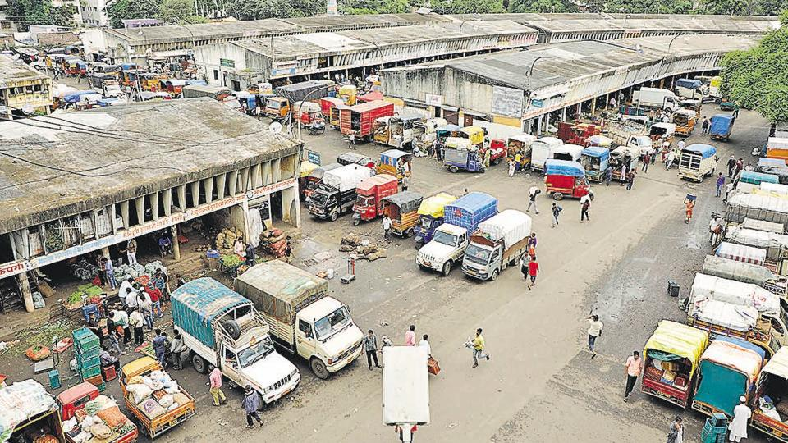
Agriculture Infrastructure
Aggregate sanctioned limit of Rs.100 crore per borrower from the banking system
Loans for construction of storage facilities (Warehouses, market yards, godowns and silos including cold storage units/ cold storage chains designed to store agriculture produce/products) irrespective of their location.
Soil conservation and watershed development.
Plant tissue culture and agri-biotechnology, Seed production, production of bio-pesticides, bio-fertilizer, and vermi composting.
Loans for construction of oil extraction/ processing units for production of bio-fuels, their storage and distribution infrastructure along with loans to entrepreneurs for setting up Compressed Bio Gas (CBG) plants
Internal
Internal

Slide 25
Ancillary activities :
Loans up to Rs. 50 crore to Start-ups, engaged in agriculture and allied services
Loans for Food and Agro-processing up to an aggregate sanctioned limit of Rs.100 crore per borrower from the banking system.
Export credit to the Agriculture sector including pre and post shipment credit
Outstanding deposits under RIDF and other eligible funds with NABARD
Loans for setting up of Agriclinics and Agribusiness Centres.
Loans to custom service units managed by Individuals, Institutions or organisations who maintain fleet of tractors, Bulldozers, Combiner etc., and undertake farm work of farmers on contract basis.
Bank loans to Primary Agricultural Credit Societies (PACS),
Farmers’ Service Societies (FSS) and
Large-sized Adivasi Multi-Purpose Societies (LAMPS)
for on-lending to agriculture
Loans sanctioned by banks to MFIs for on-lending to agriculture sector
Loans sanctioned by banks to registered NBFCs
Internal

Slide 26
KNOWLEDGE CHECK :
Loans upto Rs 10 Cr for purchase of the produce of members directly engaged in agriculture and allied activities
A) Farm Credit
B) Agriculture Infrastructure
C) Ancillary activities
D) Allied activities
Internal

Slide 27
MSME
Based on Iinvestment in P & M OR Equipment Does not exceed | T/O DOES NOT EXCEED
2.5 CRORE MICRO | 10 CRORES
25 CRORES SMALL | 100 CRORES
125 CRORES MEDIUM | 500 CRORES
MFG ( INVESTMETN IN P & M)
SERVICE (INVEST IN EQUIPMENT
MULIPLY WITH 5
Internal
Internal
27
Notes:
Kindly make use of this notes part in all the ppts.
Remember, ppt cannot have lengthy sentences
Remember the Rule of 7
7 Slide
Each Slide 7 Lines (Except in case of Definitions or legal terminology)
Each line 7 words
Kindly try to use standard font and avoid using all capital letters in sentences

Slide 28
Factoring Transactions (not applicable to RRBs and UCBs)
‘With Recourse’ Factoring transactions by banks which carry out the business of factoring departmentally wherever the ‘assignor’ is a MSME would be eligible for classification under MSME category on the reporting dates
Factoring transactions pertaining to MSMEs taking place through the Trade Receivables Discounting System (TReDS) shall also be eligible for classification under priority sector.
Internal

Slide 29
OTHER FINANCES TO MSMEs
All loans to units in the KVI sector which shall be categorised as lending to Micro Enterprises
Loans up to Rs. 50 Crore to Start-ups,that confirm to the definition of MSME
Micro & Small enterprises: On-lending by registered NBFC will be allowed up to ₹ 20 lakh per borrower
PMJDY OUTSTANDING
OUTSTANDING DEPOSIT WITH SIDBI/MUDRA
Internal

Slide 30


EXPORT CREDIT:
Domestic banks : Incremental Export Credit : 2 % of ANBC or CEOBE (Higher) subject to Sanctioned limit of Rs.50 crore per borrower
Foreign bank with 20 Branches & above : 2 % of ANBC or CEOBE Higher
Foreign bank with less than 20 Branches : Export credit upto 32 %
Internal
Internal

Slide 31

EDUCATION
Loans to individuals for ducational purposes, including vocational courses, not exceeding Rs. 25 lakh..
Internal
Internal

Slide 32


HOUSING LOAN : (Staff HL- NON-Priority)
HOUSING REPAIRS :
CATEGORY | LOAN LIMIT | MAXIMUM COST OF DWELLING UNIT
Population 50 Lac & above | 50 | 63
Population of 10 to 50 Lac | 45 | 57
Population below 10 Lac | 35 | 44
CATEGORY | LOAN LIMIT | MAXIMUM COST OF DWELLING UNIT
Population 50 Lac & above | 15 | 63
Population of 10 to 50 Lac | 12 | 57
Population below 10 Lac | 10 | 44
Internal
Internal

Slide 33
HOUSING LOAN (Employees-NP)
.
Bank loans to any governmental agency for construction of dwelling units or for slum clearance and rehabilitation of slum dwellers subject to dwelling units with carpet area of not more than 60 sq.m
Bank loans to affordable Housing projects using at least 50% of FAR/FSI for dwelling units with carpet area of not more than 60 SQ meter (FLOOR AREA SPACE/INDEX)
Outstanding deposit with NHB on account of priority short fall
Internal
Internal

Slide 34
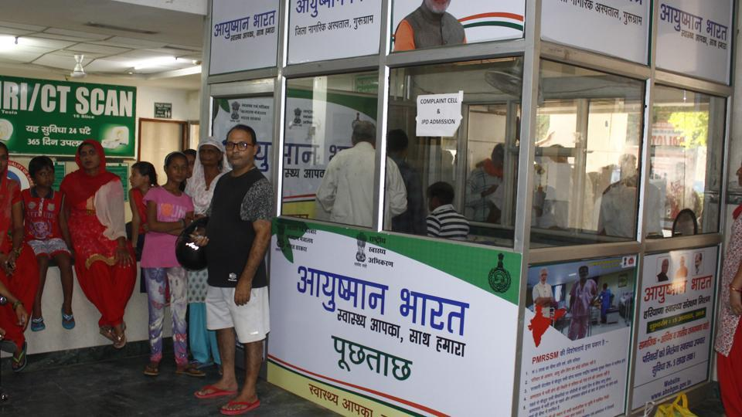
SOCIAL INFRASTRUCTURE
Bank loans of Rs. 8 crore per borrower for setting up schools, drinking water facilities and sanitation facilities including construction/ refurbishment of household toilets and water improvements at household level, etc.
Rs. 12 crore per borrower for building health care facilities including under ‘Ayushman Bharat’ in Tier 2 to Tier 6 centres.
Internal
Internal

Slide 35
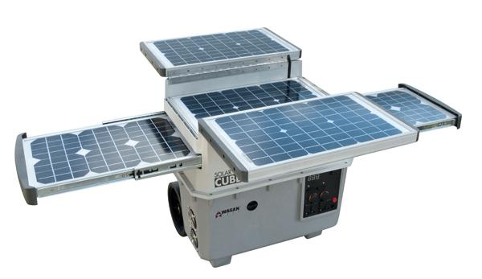
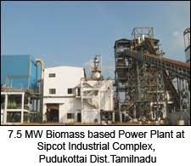

Renewable Energy
Renewable Energy : Bank loans up to a limit of Rs 35 Crore to borrowers for purposes like
Solar based power generators,
Biomass-based power generators
Wind mills,
micro-hydel plants and for nonconventional energy based public utilities, viz., street lighting systems and remote village electrification etc., are eligible for Priority Sector Classification.
For individual households, the loan limit is Rs. 10 Lakh per borrower
Internal
Internal

Slide 36
OTHER LOANS
Loans upto Rs. 2 lac provided directly by banks to SHG/JLG
for activities other than Agriculture or MSME,
viz., loans for meeting social needs,
construction or repair of house,
construction of toilets
or any viable common activity started by the SHGs
Loans to distressed persons [other than distressed farmers indebted to non-institutional lenders] not exceeding Rs.1 lac per borrower to prepay their debt to non-institutional lenders.
Loans sanctioned to State Sponsored Organisations for SC/ST s for the specific purpose of purchase and supply of inputs and/or the marketing of the outputs.
Loans up to Rs.50 crore to Start-ups, that are engaged in activities
other than Agriculture or MSME.
Internal

Slide 37
LENDING BY BANKS TO NBFCS AND MFIS FOR ON-LENDING :
Agriculture: ‘Term lending’ component under Agriculture will be allowed up to ₹ 10 lakh per borrower.(only for registered
NBFC (other than MFIs)
(NOT APPLICABLE to RRB/UCB/SFB/LAB)
Micro & Small enterprises: On-lending by NBFC will be allowed up to ₹ 20 lakh per borrower.
HFC : 20 Lac per borrower.
CAP ON LENDING : Bank credit to NBFC (including HFCs) for onlending will be eligible for PSL classification upto an over limit of 5 % of individual bankds total PSL of the previous FY.
Internal

Slide 38
Regional disparities : (VALID TILL 2026-27)
To address Regional disparities in the flow of priority sector credit at the district level
Based on per capita credit flow.
Per capita credit flow meaning : For example in a District 1 lac people are there. Total PSL loans given are Rs 50 crores.
Now 50 crores priority loans divided by 1 LAC POPULATION = Rs 5000
Ie., per capita credit flow of this village is Rs 5000/-
Now RBI SAYS : from FY 2024-25 onwards, a higher weight
125%- Incremental priority sector credit -Identified districts – where credit flow is comparatively lower (per capita PSL less than ₹9000)
90 % lower weight - identified districts –where credit flow is comparatively higher (per capita PSL greater than ₹42,000)
OTHER DISTRICTS – 100 % WEIGHTAGE
Internal

Slide 39
PRIORITY (MISCELLANEOUS)
Investments by banks in securitisation notes (not applicable to RRBs and UCBs) :
Investments by banks in ‘securitisation notes’, representing loans to various
categories of priority sector, except 'others' category, are eligible for classification
under respective categories of priority sector depending on the underlying assets
provided:
The assets are originated by banks and financial institutions and are eligible to be classified as priority sector advances prior to securitisation and fulfil the RBI guidelines on ‘Securitisation of Standard Assets’
Investment by banks in securitisation notes with loans against gold jewellery
originated by NBFCs as underlying, are not eligible for priority sector status
PRIORITY SECTOR LOANS UP TO ₹50,000 : NO CHARGES
Internal

Slide 40
PRIORITY (MISCELLANEOUS)
. Inter Bank Participation Certificates (IBPCs) (not applicable to UCBs) :
IBPCs bought by banks, on a risk sharing basis, are eligible for classification under priority sector, provided the underlying assets are eligible to be categorized under the respective categories of priority sector
IBPCs bought by banks, on a risk sharing basis relating to Export credit shall be classified from purchasing bank perspective for priority sector categorization.
.
Bank loans to MFIs: (Below are eligible to classify for priority categorization)
Banks are allowed to extend credit to registered NBFC-MFIs and other MFIs (Societies, Trusts etc.) which are members of RBI recognised SRO for the sector, for on-lending to individuals and also to members of SHGs / JLGs.
SFBs are allowed to extend fresh credit to registered NBFC-MFIs and other MFIs (Societies, Trusts) which are members of RBI recognised ‘Self Regulatory Organisation’ of the sector, and which have a ‘gross loan portfolio’ (GLP) of up to ₹500 crore as on Mar 31 of the previous year, for the purpose of on-lending to individuals. (Overall limit permitted is 10 % of bank total PSL of previous FY)
Internal

Slide 41
PRIORITY
Priority Sector Lending Certificates (Ref: RBI NOTIFICATION 7.4.16)
PSLC CERTIFICATES : NO Transfer of Risk or Loan
CBS PORTAL- e-KUBER – Rs 25 lacs and Multiples of Rs 25 lacs
4 type of PSLC CERTIFICATES
PSLC - GENERAL : (COUNTING FOR OVERALL)
PSLC-AGRICULTURE (COUNTING FOR AGCL AND OVERALL)
PSLC - SF/MF (COUNTING FOR SF/MF & OVERALL)
PSLC-MICRO ENTERPRISES (COUNTING FOR MICRO & OVERALL)
Sellers/Buyers : SCBs,(RRBs), Local Area Banks, SFB and Urban Co-operative Banks
Amount eligible for issue : 50% previous year’s PSL achievement
Expiry date: All PSLCs will expire by March 31st and will not be valid beyond the reporting date
Internal

Slide 42
COMPLIANCE - Monitored on ‘Quarterly’ Basis
Priority data to be furnished to :
FIDD, Central Office ,RBI @
Quarterly (15 days from end of quarter) and
Annual intervals (with in a month from annum)
RRBs ………TO……NABARD (QUARTERLY AND ANNUAL)
Internal

Slide 43
PRIORITY
NON ACHIEVEMENT
RIDF (RURAL INFRASTRUCTURE DEVELOPMENT FUND) OF NABARD
OTHER-FUNDS AS DECIDED BY RBI
NABARD (AGCL)
NHB (HOUSING)
SIDBI (MSME)
MUDRA LTD (MSME)
ROI & TENURE OF WILL BE DECIDED BY RBI
Internal

Slide 44
PRIORITY
NON ACHIEVEMENT
ROI & TENURE OF WILL BE DECIDED BY RBI
SI | Shortfall in overall priority sector lending target | Deposit Rates
1 | Less than 5 % points | Bank rate -2 % points
2 | 5 to 10 % points | Bank rate -3% points
3 | 10 % percentage points and above | Bank rate -4% points
Internal

Slide 45
Terminal Questions
What is the total Priority sector target to be achieved by Domestic Commercial banks
1) 40% 2) 32% 3) 10% 4) 75% 5) 18%
Answer is 40%
Internal

Slide 46
Terminal Questions
In the total Priority sector target how much is to be achieved towards Agriculture by Domestic Commercial banks
1) 40% 2) 32% 3) 10% 4) 75% 5) 18%
Answer is 18%
Internal

Slide 47
Terminal Questions
In the total Priority sector target how much is to be achieved towards Advances to weaker section by Domestic Commercial Banks
1) 40% 2) 12% 3) 10% 4) 75% 5) 18%
Answer is 12%
Internal

Slide 48
Terminal Questions
What is maximum loans against pledge/hypothecation of Agricultural produce (including warehouse receipts) for a period not exceeding 12 months subject to a limit up to ₹……. lakh against warehouse receipts other than NWRs/eNWRs
1) 25 2) 45 3) 75 4) 50 5) 30
Answer is 50 lakhs
Internal

Slide 49
Terminal Questions
What is the maximum amount under education loan to be classified under priority sector (Rs. In lakhs)?
1) 25 2) 20 3) 75 4) 50 5) 30
Answer is 20 lakhs
Internal

Slide 50
Terminal Questions
Lending to startups up to ₹_____ Cr per borrower can be classified under Priority sector
1) 25 2) 20 3) 75 4) 50 5) 30
Answer is 50 Crores
Internal

Slide 51
Terminal Questions
Lending to Distressed farmers up to ₹_____ lakh per borrower can be classified under Priority sector
4
3
6
NO LIMIT
1
Answer is NO LIMIT
Internal

Slide 52
Terminal Questions
Loans for Food and Agro-processing up to an aggregate sanctioned limit of Rs.100 crore per borrower can be classified under
Farm credit
Ancillary activity
AGRICULTURE INFRASTRUCTURE
MSME
Others
Answer is Ancillary activity
Internal

Slide 53
Terminal Questions
Monitoring of priority lending compliance of banks by RBI is done on _______ basis
Monthly
Quarterly
Half yearly
Daily
Answer is Quarterly
Internal

Slide 54
Terminal Questions
Loans for Food and Agro-processing up to an aggregate sanctioned limit of Rs. --------- Cr per borrower can be classified under Priority sector
25
50
75
100
Answer is 100
Internal

Slide 55
Terminal Questions
______per borrower for building health care facilities including under ‘Ayushman Bharat’ in Tier 2 to Tier 6 centres
1 Crore
2 Crores
5 Crores
10 crores
Answer is 10 Crores
Internal

Slide 56
Terminal Questions
No processing charges to be collected for priority sector loans upto Rs.______
10,000
25,000
50,000
1 lakh
Answer is 25,000
Internal

Slide 57
Terminal Questions
Bank loans to any governmental agency for construction of dwelling units or for slum clearance and rehabilitation of slum dwellers subject to dwelling units with carpet area of not more than __ sq.m
40
50
60
75
Answer is 60
Internal

Slide 58
Terminal Questions
If Banks does not ACHIEVE Priority sector target, The deficit amount is not to be invested in _____
RIDF of NABARD
NHB
SIDBI
MUDRA LTD
HFC
Answer is HFC
Internal

Slide 59
Terminal Questions
Loans to farmers against pledge/ hypothecation of agricultural produce (including warehouse receipts) for a period not exceeding __ months will be classified under priority sector target
18 months
12 months
6 months
24 months
Answer is 12 months
Internal

Slide 60
Terminal Questions
Incremental Export Credit : 2 % of ANBC or CEOBE (Higher) subject to Sanctioned limit of ______per borrower will be classified under priority sector target
Rs.10 crore
Rs.20 crore
Rs.30 crore
Rs.40 crore
Answer is Rs.40 crore
Internal

Slide 61
Terminal Questions
Loans up to Rs. ___ Cr per borrowing entity to FPOs/FPCs undertaking farming with assured marketing of their produce at a pre-determined price under FARM CREDIT
Rs.1 crore
Rs.2 crore
Rs.5 crore
Rs.10 crore
Answer is Rs.5 crore
Internal

Slide 62
Terminal Questions
Bank loans up to a limit of Rs ____to borrowers for purposes like Solar based power generators, Biomass-based power generators Wind mills etc comes under renewable energy category of Priority sector.
Rs.10 crore
Rs.20 crore
Rs.30 crore
Rs.40 crore
Answer is 30 Crore
Internal

Slide 63


Internal
Internal

